Slide 1
Taco Sales Forecasting
By: Michael McGivern

Slide 2
Problem Statement
To build and deliver a forecasting and analytics solution for taco sales to help a restaurant chain optimize inventory planning, pricing, and promotion strategies

Slide 3

Technology stack
Python (Pandas, NumPy, SciPy) for data cleaning, analysis and statistical test
Matplotlib, Seaborn and Plotly for Visualizations
Jupyter Notebook for Exploratory Analysis
Sklearn for Machine Learning algorithms
Tensorflow Keras for Deep Learning Neural Networks
PowerPoint for Storytelling and reporting

Slide 4

Features of dataset​
Order ID
Restaurant Name
Location
Order Time
Delivery Time
Delivery Duration
Taco Size
Taco Type
Toppings Count
Distance
Price
Tip
Weekend Order

Slide 5
Exploratory data analysis
With Statistical Summary

Slide 6
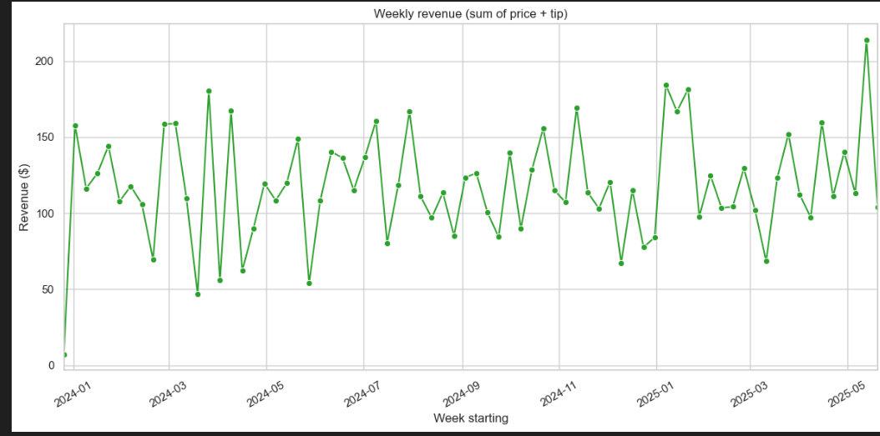
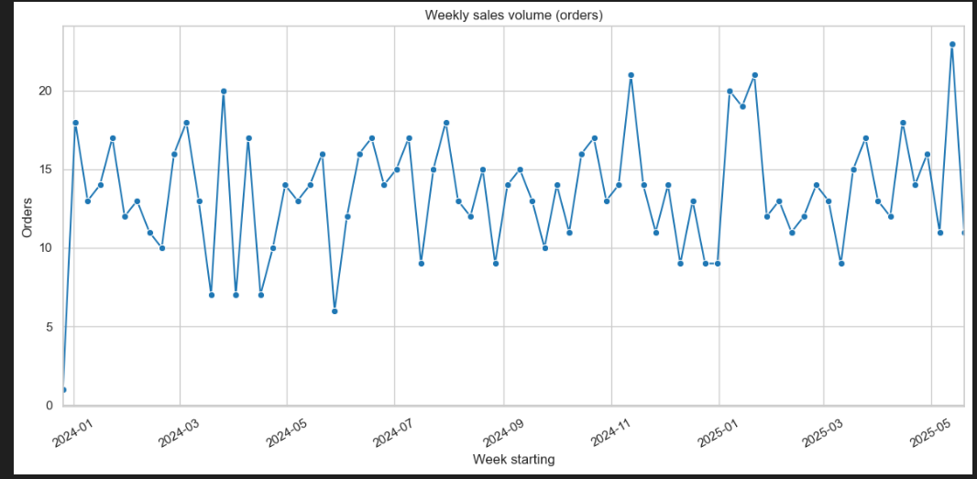
Weekly order volume and Revenue

Slide 7
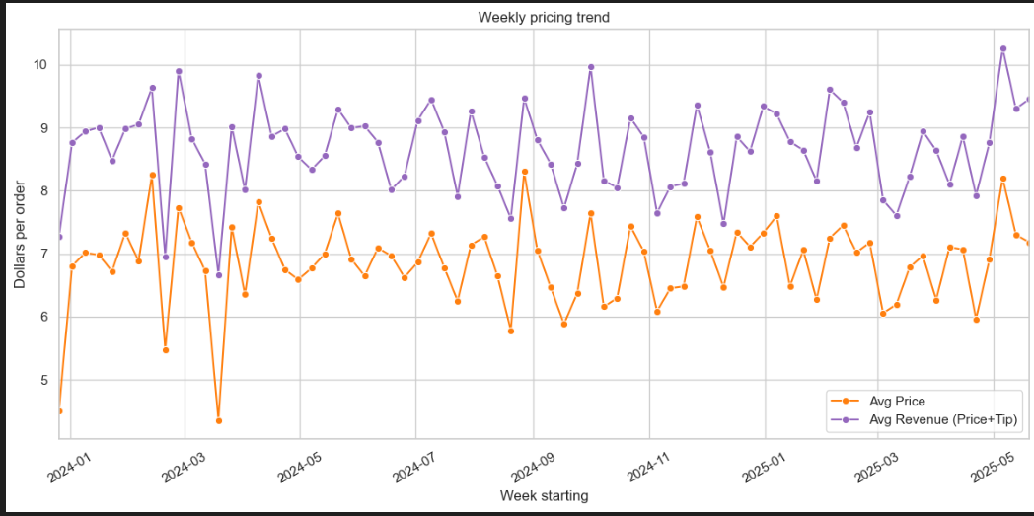
Weekly pricing trends

Slide 8
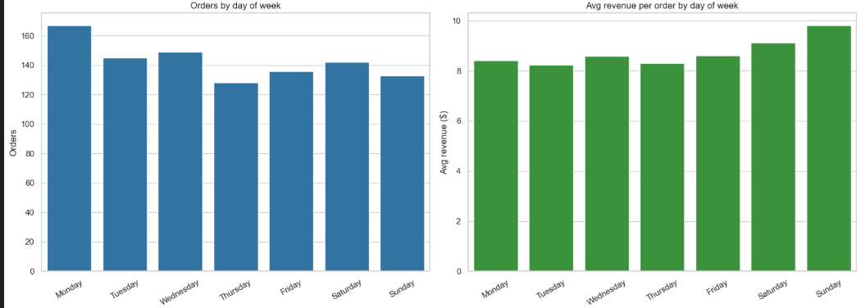
Orders and revenue by day of week

Slide 9
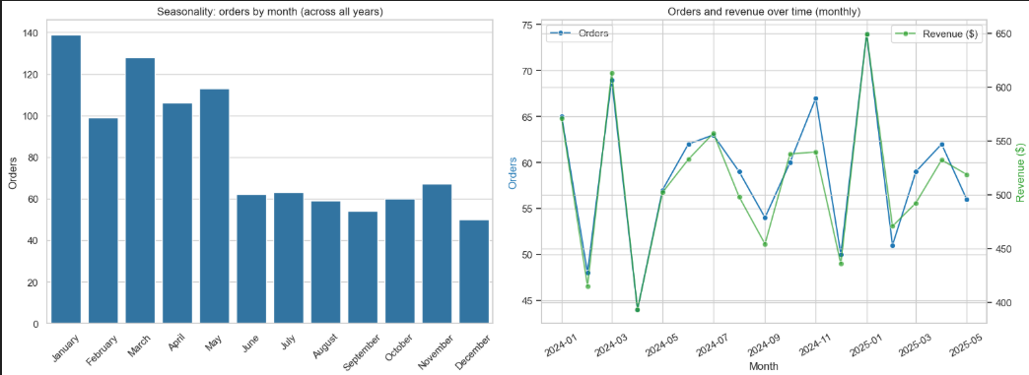
Seasonal orders and revenue

Slide 10
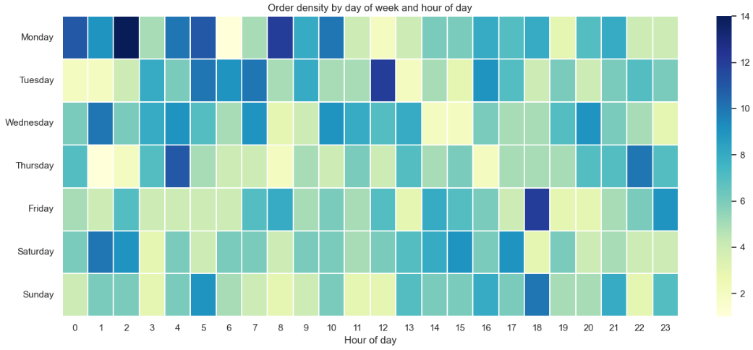
Order density by weekday and hour​

Slide 11
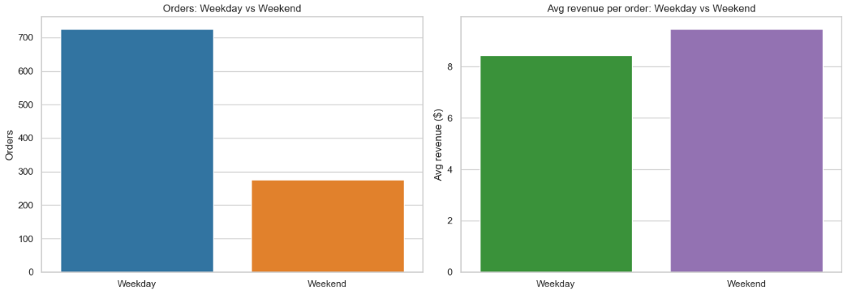
Orders and revenue, weekday vs weekend

Slide 12
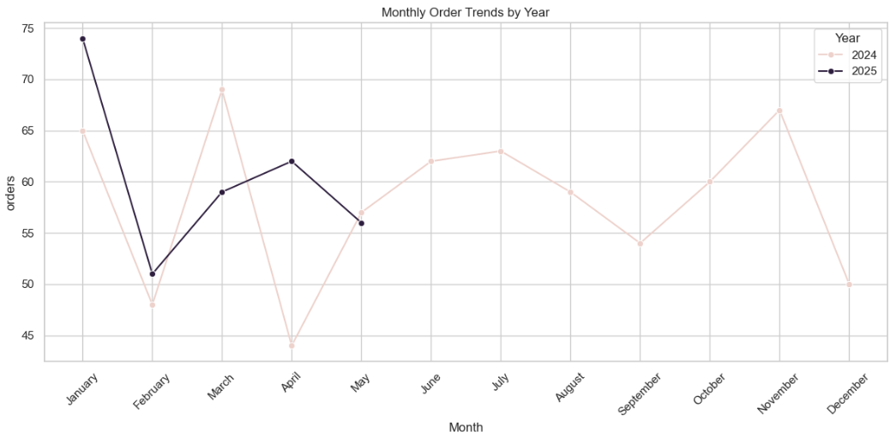
Monthly order trends by year

Slide 13
Time series Forecasting

Slide 14
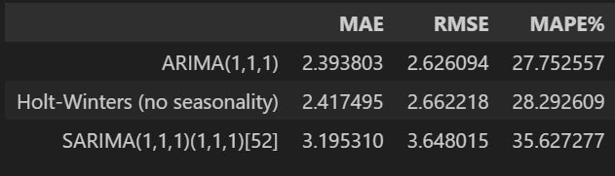
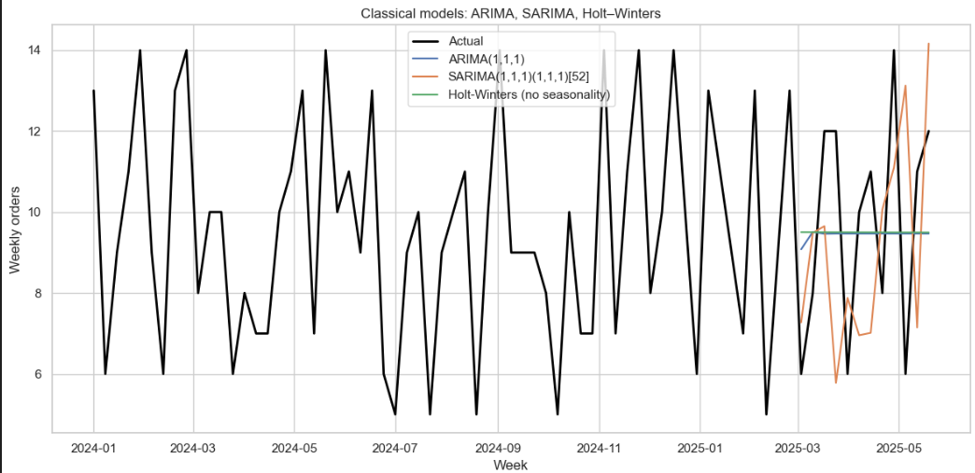
ARIMA, SARIMA and Holt-Winters Prediction and accuracy

Slide 15
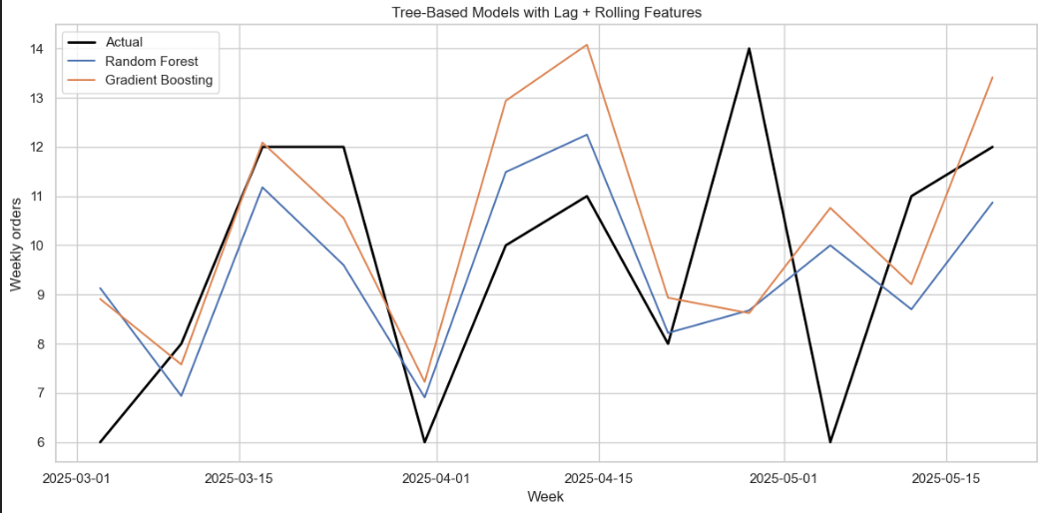
Random Forest and Gradient Boosting with lag rolling

Slide 16
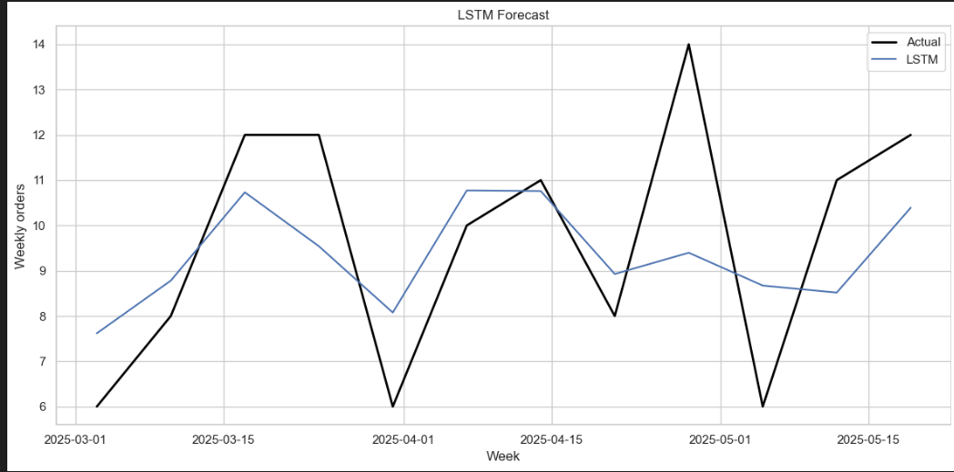
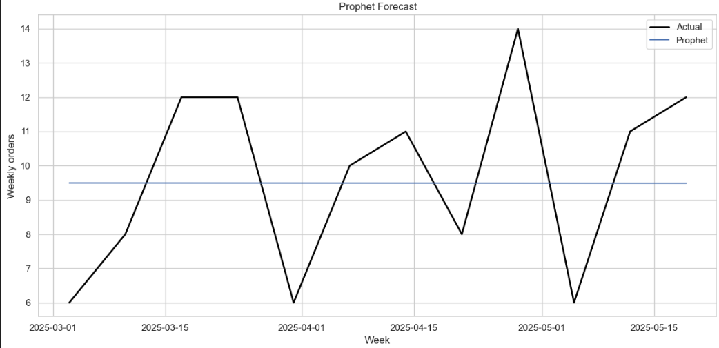
LSTM and Prophet neural networks

Slide 17
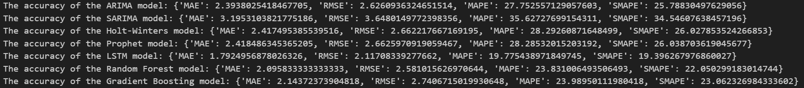
Best Model forecast

Slide 18
Price Optimization prediction

Slide 19

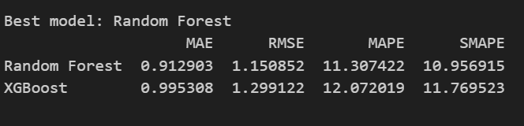
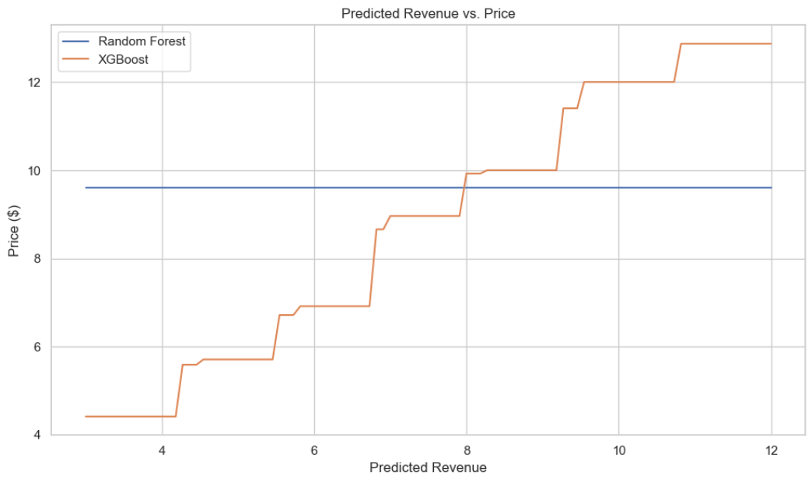
Random Forest and XGBoost training, testing and selection

Slide 20
PowerBI

Slide 21
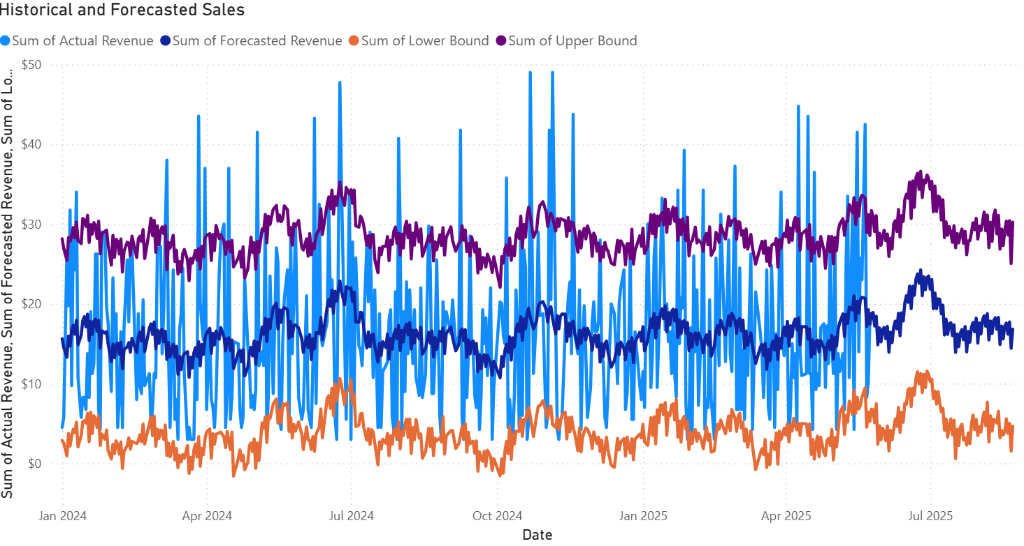
Historical and Forecasted sales

Slide 22
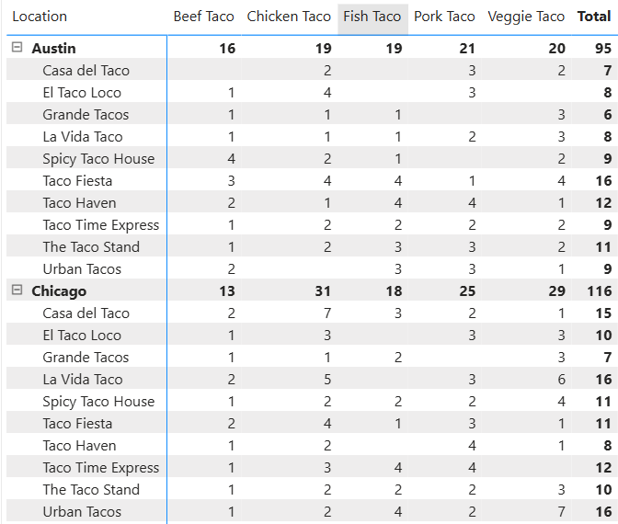
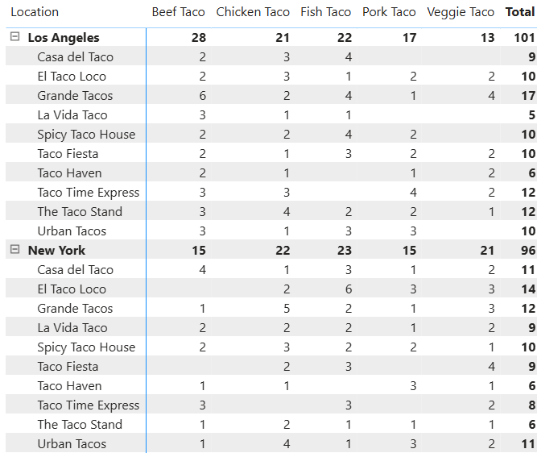
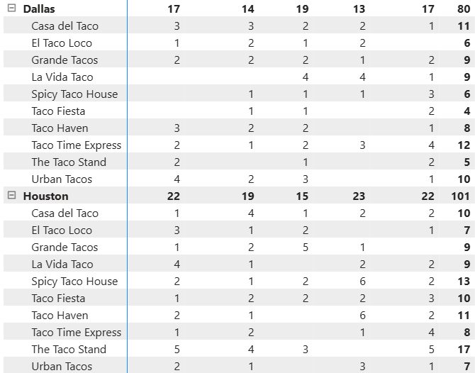
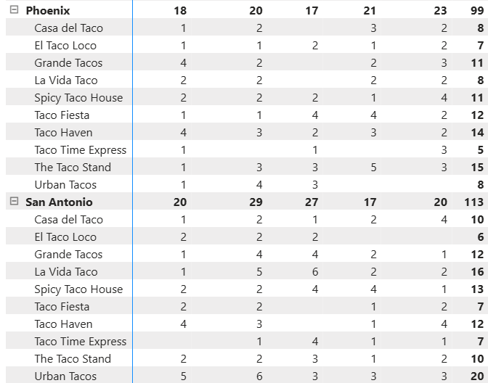
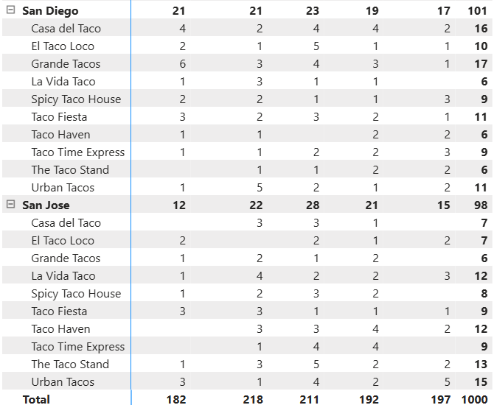
Inventory Needs

Slide 23
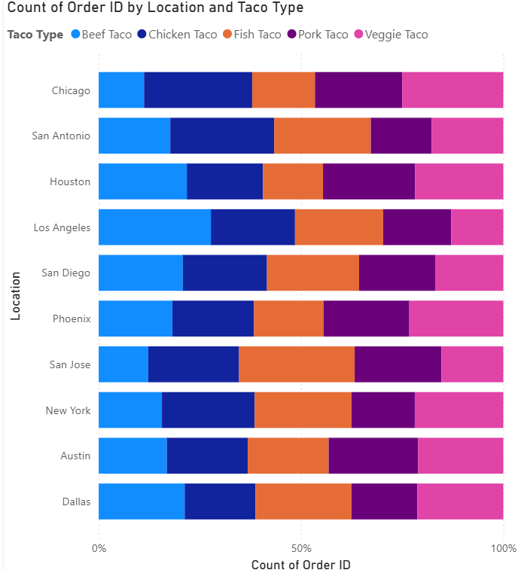
Inventory proportions

Slide 24
Future scope
Researchers should continue to collect data on:
Induvial inventory prices, customer satisfaction, inventory shelf life, labor costs, operational cost

Slide 25
Target Audience
This report is targeted towards:
Company executive
Franchise owners
Managers
Financial and Logistical Professionals
Data Analysts

Slide 26
Thank you

